Slide 1
Water Crisis in Pakistan
Allahdad

Slide 2
Introduction
Water abounded countries
Water stressed countries
Water scarced countries

Slide 3
Introduction
WATER CRISIS
Water crisis in simple terms defined as insufficient or depleted freshwater resources that can no longer serve the standard water demand of a particular area

Slide 4
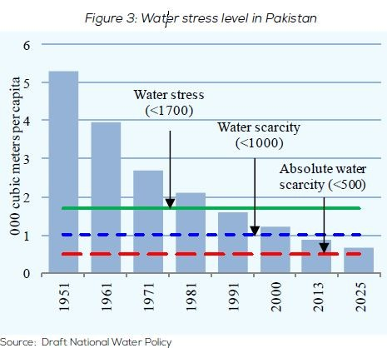

Slide 5
In Pakistan there is an IRS system in which total water is 170 MAF.
Pakistan only get 137 to 145 MAF
Pakistan got three river in Indus water treaty Indus,Jhelum,Chanab through these rivers Pakistan get 109 MAF water
In 1951 Pakistan recorded as the water abounded country it has 5600 meter cube per capita
In 1991 Pakistan has 1800 meter cube per capita
In 2016 it reduced to 1000 meter cube per capita
According to UNDP and Word bank report in 2025 Pakistan will be counted as water scarce country.
500 meter cube per capita

Slide 6
According to IRSA report every year Pakistan get 145 MAF water which comes through rainfall and glacier
50-55 MAF through ground water
20% GDP consist of agriculture
93% of water is consumed by agriculture
5% industries
2% domestic use
49% of water wasted due to evaporation ,leakage,seepake,water theft

Slide 7
Main Issues of Water Crisis
1)Usage problems:
95-102 MAF of water used in agriculture
12 MAF of water wasted in process loss
25% of water wastage to sea annually 34 MAF of untreated water flow to sea

Slide 8
Main issues of water crisis
2)External issue:
78% of water comes from outside through Indus,Chanab,Jhelum,Kablu rivers .
This water supply can be blocked
3)Moonson water issues :
80% of water approximately 110 MAF supply to Pakistan in 100 days .Pakistan comes in overflow .

Slide 9
Main issues of water crisis
4)Water usage per capita:
According to some reports and news like Dawn and some independence surveys Pakistani use 100 gallons per day on the other hand world standard is 10 gallons per day
Over usage (efficiently usage lacking)
5)Ground water :
Pakistan get 50-55 MAF of water through ground
40% of this water is brackish
260,000 tube wells already aquifers are getting depleted.

Slide 10
Main issues of water crisis
6)Per capita water availability:
Pakistan has 940m3/day per person
Minimum standard in world is 1000 m3 per/capita
Pakistan is counted as water scare country
7)Availability of clean drinking water:
25-50 % people in Pakistan do not have clean water for drinking
According to independence research article “third pole” survey in Karachi 91% of water in Karachi is not drinkable

Slide 11
Main issues of water crisis
8)Water storage :
Pakistan has only 30 days of water storage capacity.
13.86 Maf stored in 3 dams Tarbela,Mangla,Chashma.
Comparasion to the world’s dams China has 22000 dams ,India has 4000 dams , and Pakistan has only 71 dams
Egypt 1000 days, USA 900 days ,India has 170 days .
9)Kotri ecosystem issue

Slide 12
Effects of Water crisis on Pakistan
Lack of drinking water
Less crop yield
Urban Sprawl
Loss of wetlands
Insufficient Sanitation

Slide 13
Lack of drinking water
Water crisis can lead to the unavailability of Drinking water Many people in the country don’t have access to drinking water.

Slide 14
Less crop yields
The high level crop is already damaged due to shortage Of water In Pakistan .Fewer crops yields ultimately Results in Economic crisis as a well as food In security.

Slide 15
Uraban sprwal
Lacking access to freshwater resources Is causing people to move towards Urban areas for Facilities being Available there.

Slide 16
Loss of wetlands
Water crisis in equally harmful to the sustainable Environment .water crisis in the result of loss of wetlands

Slide 17
Insufficient sanitation
People Are not having Sufficient sanitation Facilities Due to water crisis Issues And health problems Related to Water borne Diseases are common among people

Slide 18
Causes of Water Crisis in Pakistan
Climate Change
Inadequate water management
Depleting aquifers
Water pollution
Political crisis

Slide 19
Climate change
Climate change is stressing the availability of freshwater resources In Pakistan. The country is facing extreme Ecents leading To water crisis

Slide 20
Inadequate water management
There is a lack of adequate Management Practices in Pakistan The old irrigation System is one of the example

Slide 21
Depleting aquifers
The underground water aquifers Are not getting recharged due to High demand of water.
Water pollution
Industries Are washing up In nearby the freshwater resources Such as rivers canal streams Etc .The unsupervised Drainage Systemis contaminating freshwater resources.

Slide 22
Political crisis
Political crisis in Pakistan is among the main causes that lead to the water crisis Pakistan and India signed the Indus water treaty .
India and Afghanistan is making the dams on the rivers of Pakistan
Provisional dispute on water

Slide 23
Solutions to Water Crisis in Pakistan
Improved Irrigation System
Construction of Water Reserves
Awareness through Save Water Campaign
Rainwater Harvesting
Water Management/ Water Conservation
Sea Water Desalination Plants

Slide 24
Improved irrigation system
There is an immense need To improve and follow New technology related To irrigation system.
Construction of water reservoirs
Water can only be conserved by constructing the water Reservoirs such as Dams,canals etc.

Slide 25
Awareness through Save water compaigns
People Should be made aware to the water crisis through Save water compaigns
Rain fall harvesting
Rainfall harvesting System is one of the solutions that can help in water Conservation . If the average rainfall average annuallly increase than water crisis is soved.

Slide 26
Water conservation
Adequate water management Plans can be recommended solutions
Proper water distribution plans
Proper use of water

Slide 27
THANK YOU FOR YOUR ATTENTION

